Slide 1

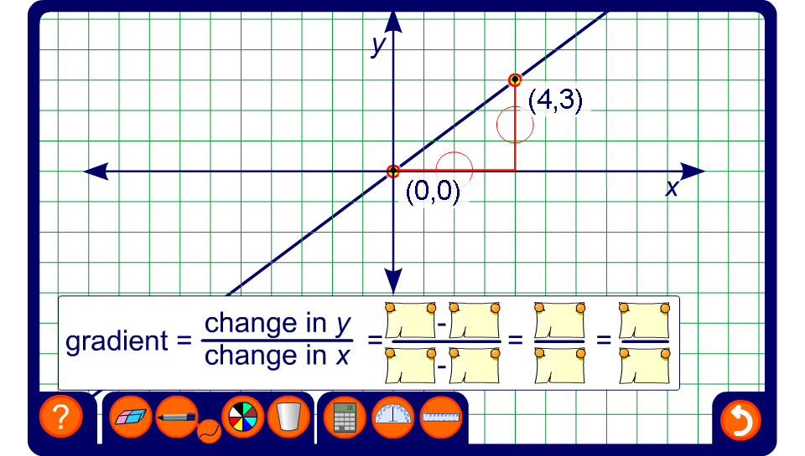


Calculating gradients
Notes:
By looking at a variety of examples establish that if we are given the coordinates of any two points on a line we can find its gradient by taking the y-coordinate of the first point subtracted from the y-coordinate of the second point and diving it by the x-coordinate of the first point subtracted from the x-coordinate of the second point.
Demonstrate to pupils that when the line slopes downwards the change in the vertical distance is negative as we move from left to right and so the gradient is negative.
Show that choosing different points on the same line will give the same gradient using equivalent fractions. For example, if the vertical distance between the end points is 6 and the horizontal distance between the end points is 4, the gradient of the line is ³/₂. If we change the vertical distance to 9 and the horizontal distance to 6, the gradient of the line is still ³/₂.
Point out that it is often most useful to leave gradients as improper fractions. For example, the gradient ³/₂ tells us that for every 2 squares we move along we move 3 up.
Hide the value of the gradient and ask pupils to tell you the gradients of given lines. Include gradients that need to be cancelled down and negative gradients.
Ask volunteers to come to the board and vary the points to give lines of specified gradients.
For example, if you ask the volunteer to make a line with a gradient of –2 they could have the horizontal distance between the end points as 5 and the vertical distance between the end points as –10.

